Slide 1
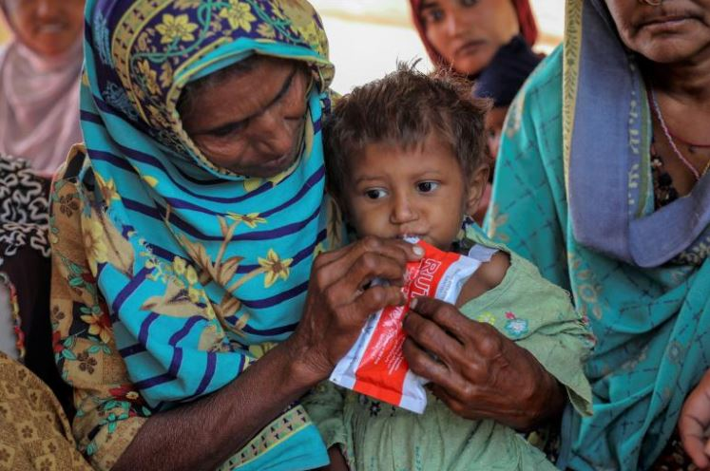
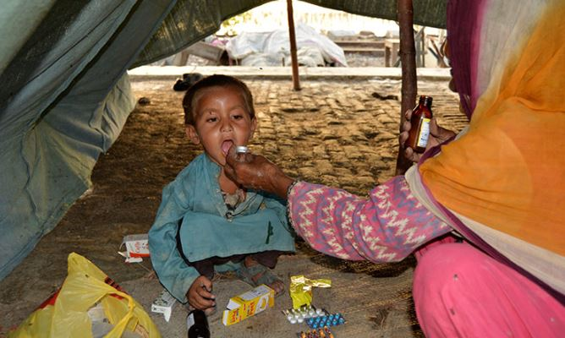
Evaluating the role of social transfers on child development: Quasi-experimental evidence from Sindh By: Ali Haider Supervisor: Dr. Syed Hassan Raza

Slide 2

Introduction
What are social transfers?
The early years of childhood are critical for the development of a young child (UNICEF, 2012).
Does income play any role in the development of a child?
ANS: (Cooper and Stewart, 2021) (Macours et al., 2012).
Intensive preschool intervention improves children's outcomes significantly in multiple domains (Manning and Patterson, 2006).
This study isolate causal impact of social transfers on child development

Slide 3
Quasi-experimental research, A suitable approach to assess causal effects of interventions by dividing the population into treated and control groups.
Vast amount of empirical research focuses on neonate child mortality because Pakistan has one of highest neonate mortality (world bank, 2020)
It is important to know whether the surviving child is developmentally on track or not

Slide 4
Objectives of the study
The primary goal of this research is to guide policy decisions on the use of social transfers as a tool to improve child development
Investigating the impact of social transfers on child development's magnitude

Slide 5
LITERATURE REVIEW

Slide 6
Title | Authors | Journel | Findings
Boys' cognitive skill formation and physical growth: Long-term experimental evidence on critical ages for early childhood interventions | Barham et al., (2013) | American Economic Review | interventions during the first 1,000 days can positively affect children's cognitive development. At age 10, boys exposed to intervention have less impact than those exposed in their second year of life.
Causes and consequences of early-life health | Case and Paxon, (2010) | American Economic Review | . They examined the factors that effect child development and have long-term effects poverty, poor diet,, lack of access to health care, and negative experiences such as abuse or neglect, using data from the 1979 National Longitudinal Surve of US
Association between stunting and early childhood development among children aged 36–59 months in South Asia. | Kang et al., (2018) | Maternal and child nutrition | HAZ, and WAZ are linked to the developmental domain of learning/cognition in Bangladesh, Punjab (Pakistan), and Sindh provinces. The stunted child have more possibility to remain developmentally off-track

Slide 7





Data
DATA IS TAKEN FROM MULTIPLE Indicator Cluster Survey Sindh-2018.
A cross-sectional Data.
Notes:
One mjr shrtcmof cross-sec data is, it provide point est nd not allow for exa of chng ovr tym which may not indicate true causation. Meth emph hel to est caus

Slide 8
This study used propensity scores for analyzing the effect of social transfers intervention. Propensity scores estimate the probability of being exposed to intervention given the household, child and parental characteristics of child. Subjects with similar propensity scores have similar baseline covariates
Covariates are the variables which influence child development
Social transfer is intervention which includes Zakat-Bait-ul-maal, BISP, khidmat card, any retirement pension benfits, watan / sehat card, or any other external assistance program
Notes:
To isolate the effect of child dev from other factor that maynfluence child dev, covariates are used. Covariates r pre-tretmnt chrtr tht affct chld exposur to intrvn

Slide 9
The propensity scores of children are obtained through regression that estimates the probability of being exposed to social transfers intervention given their parental and household characteristics.
Propensity score is generated for each observation based on coefficients of covariates to establish a counterfactual group for treated, i.e., control
The causal impact of treatment for a population is estimated by ATT (Average Treatment Effect) for the Treated after matching.
ATT = E {Y(1) – Y(0)| X=1} here second term is counterfactual, which tells us what would expect to happen if ith child did not receive social transfers

Slide 10
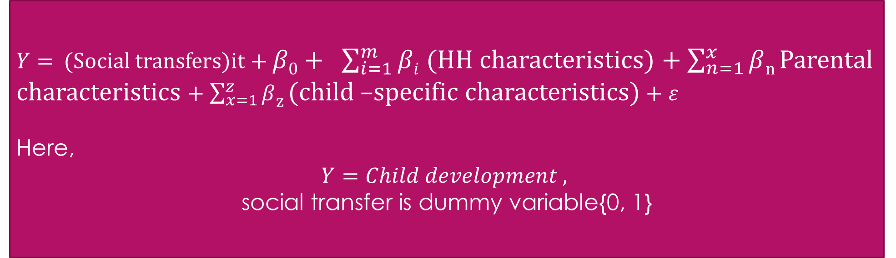
Model
$Y=$ (Social transfers)it + $β0+ \sum_{i=1}^{m}{βi}$ (HH characteristics) + $\sum_{n=1}^{x}{β}$_{n} Parental characteristics + $\sum_{x=1}^{z}{β}$_{z} (child –specific characteristics) + $ε$
Here,
$$Y=Child development ,$$
social transfer is dummy variable{0, 1}

Slide 11
Variables | Variable discrption | Variables | Variable discrption
Child-development | Outcome variable | Social transfer | Treatment variable
Child’s weight | . The child weight variable is a continuous variable with index ranges from 1.2 to 33.4 | Have computer | Binary
Age of the father | Age (1=< 25), (2= < 41 & <25 )and (above 40 =3) (Base: Under 25) | Drink treated water | Binary
Household size | Size (1=<4), (2=< 7 &<4) (3= < 9 & < 6 )4=above 8)(Base: Under 4) | Have mobile | Binary
Mother Education | Base: Unschooled | Own house | Binary
Vaccination | Binary | Number of Children | Numeric variable
Vitamin/Zinc supplements | Binary | Area | Binary
Ever breast feed | Binary | HH member with ban a/c | Binary

Slide 13
Results And Discussions

Slide 14
Notes:
Mahalnobus, Nearest ngbr, bootstrapping S.Eis used to estimate the standard error of the treatment effect in the original P.S-matched sample

Slide 15
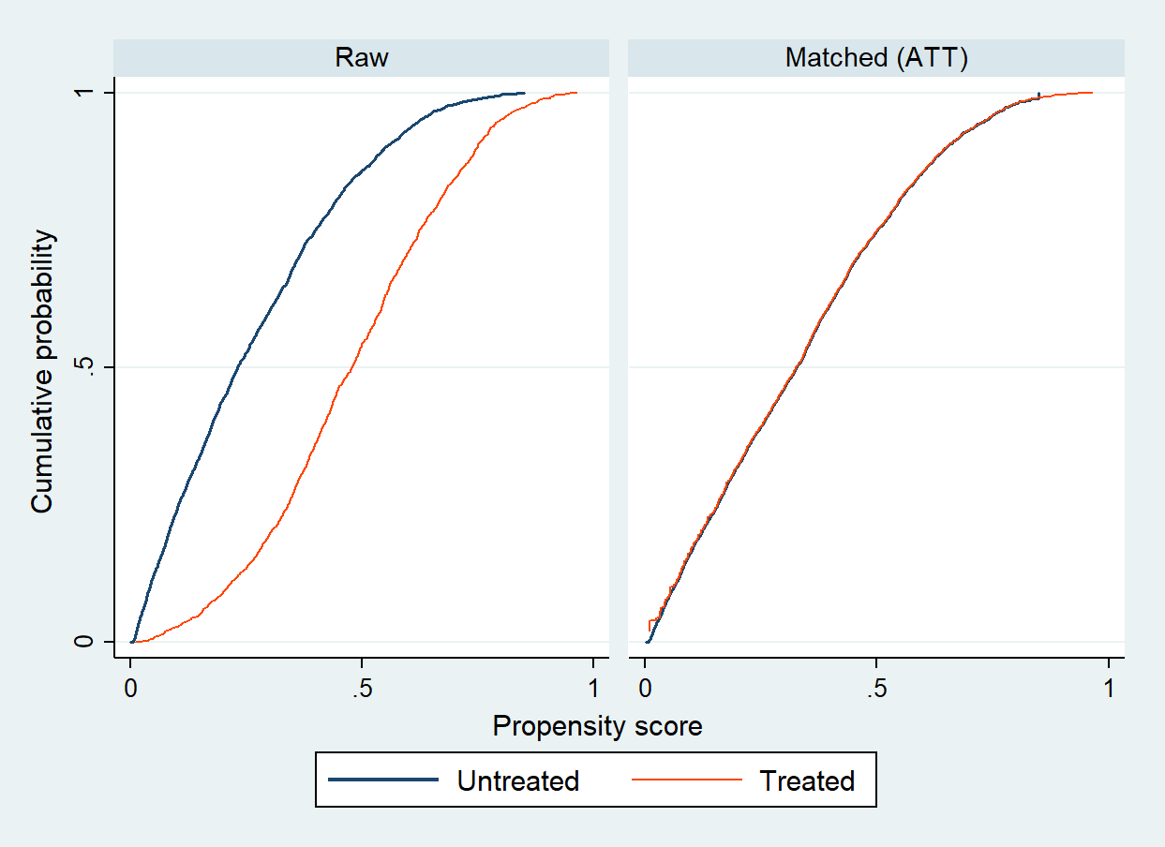
Notes:
P.S for the treated child and control before and after matching overlap in their PS distributions.

Slide 16
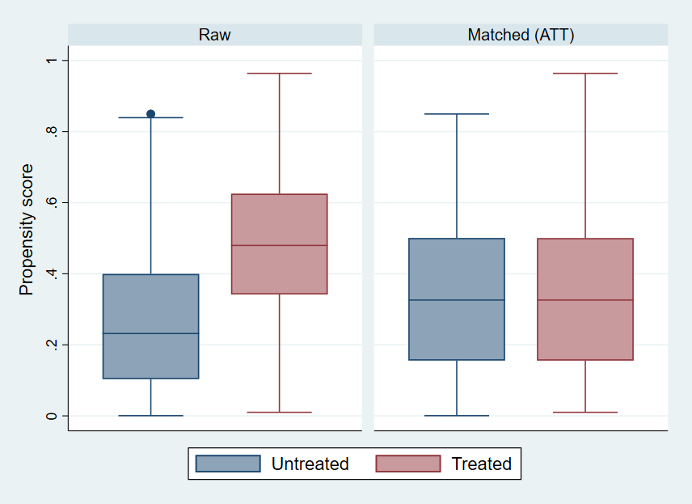
Notes:
There is a close match between the treatment and untreated groups

Slide 18
v

Slide 19
CONCLUSION
Social transfer affects the development of the male child; however increases the likelihood of risk to development for girls in HH receiving social transfers, but this effect is not statistically significant.
The marginal effect revealed that poverty, mother's education, father's age, and larger HH size positively and significantly influenced child development in the household receiving social transfers. In contrast, cell phone use and a higher number of children in households negatively affect child development

Slide 20
Policy Implications
15% of Pak population are under the age of five years, this could be turned into a great human by targeting under five year child development through social transfers like interventions
The causal gender specific results suggest that Government should try to change patriarchal gender norms of people receiving transfers through education seminars.

Slide 21
LIMITATIONS
The study use MICS Sindh 2018 data, one time period data is used in study without carrying the history of respondents over time, so did not have data of their medical or genetic history that might influence child development.
There are chances of wrong mother’s assessment of child development or biased reporting by mother.

Slide 22
Thank You

Slide 23
Questions??

Slide 24
